Slide 1


Index trend prediction
Joy
Karlie
Patrick
Masha

Slide 2
Table of contents
1
2
3
4
Motivation
Exploratory data
analysis
Building a model
Results
Literature review
1

Slide 3
Motivation
1
We want to use neural network combined with big data analysis to obtain a model that can better predict the future index trend and improve the return of trading strategies
Based on our literature review, we find that LSTM, random forest and some other models have impressive performance and are used by some famous global quantitative funds
We want to use the knowledge in this class to optimize the model and process the data
2
3

Slide 4
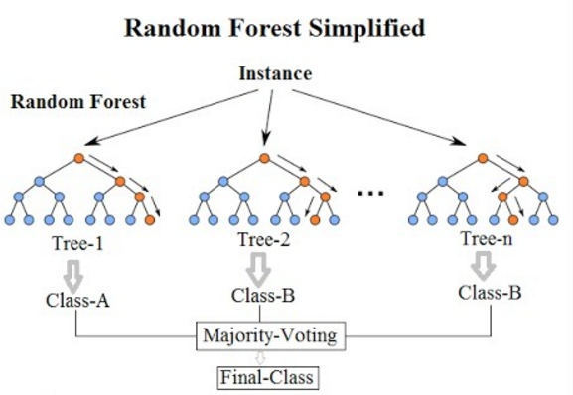
Literature Review: Random forest
Random forest is an ensemble learning method commonly used for classification and regression
It operates by constructing a multitude of decision trees at training time
Outputs the class that is the mode of the classes (classification) or mean prediction (regression) of the individual trees
Random decision forests correct for decision trees' habit of overfitting to their training set

Slide 5
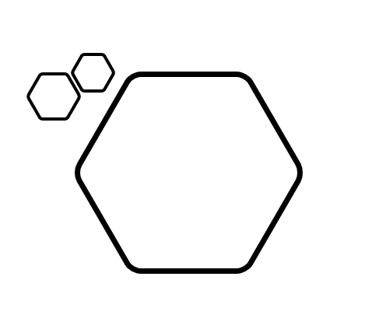
Features of Random Forests
Unexcelled in accuracy among current algorithms
Runs efficiently on large datasets
Can handle thousands of input variables without variable deletion
Gives estimates of what variables are important in the classification
Generates an internal unbiased estimate of the generalization error as the forest building progresses
Has an effective method for estimating missing data and maintains accuracy when a large proportion of the data are missing

Slide 6
Features of Random Forests
Has methods for balancing error in class population unbalanced data sets
Generated forests can be saved for future use on other data
The capabilities mentioned before can be extended to unlabeled data, leading to unsupervised clustering, data views and outlier detection
Random forest offers an experimental method for detecting variable interactions

Slide 7
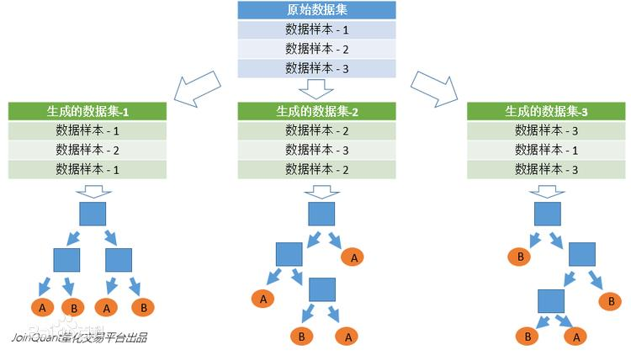
Random forest construction
First of all, a sampling with replacement is taken from the original data set to construct a sub-data set
The data amount of the sub-data set is the same as the original data set
Elements in different sub-data sets can be repeated, and elements in the same sub-data set can also be repeated

Slide 8
Random forest construction
The sub-decision tree is constructed using the sub-data set
This data is put into each sub-decision tree, and each sub-decision tree outputs a result
If new data is needed to obtain classification results through random forests, the output of random forests can be obtained by voting on the judgment results of sub-decision trees

Slide 9
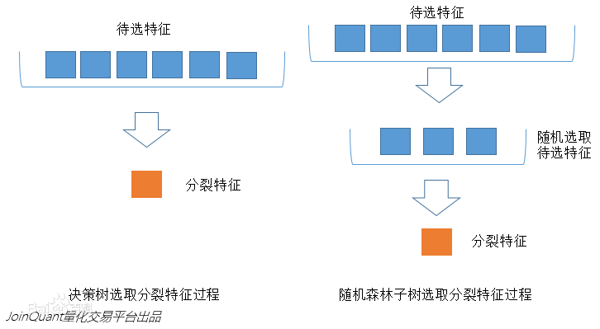
Random forest construction
Each splitting process of the subtree in the random forest does not use all the features to be selected, but randomly selects certain features
Selecting the best feature from the features can make the decision trees in the random forest all different from each other
Thus, it mproves the diversity of the system and improves the classification performance

Slide 10
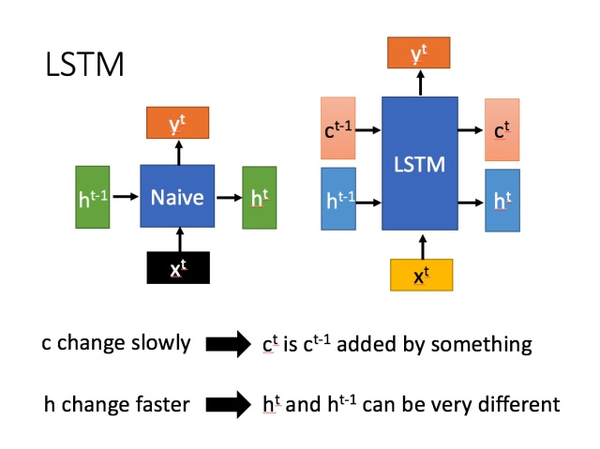
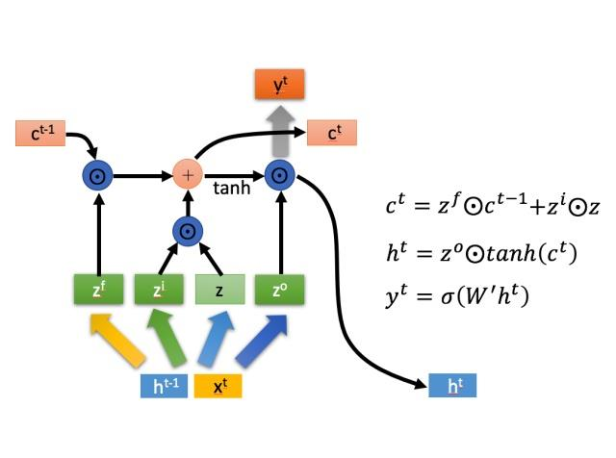
LSTM
Long short-term memory (LSTM) is a special RNN, which is mainly used to solve the problem of gradient disappearance and gradient explosion
Compared with ordinary RNN, LSTM can perform better in longer sequences

Slide 11
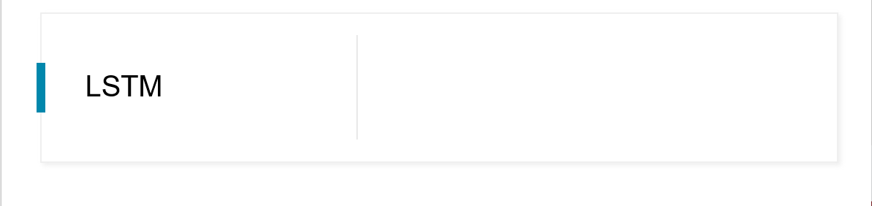
There are three main phases in LSTM
1. Forget. Selectively forget the input from the previous node 2. Select. Selectively "remembers" the input of this stage 3. Output. Determine which outputs will be treated as the current state

Slide 12
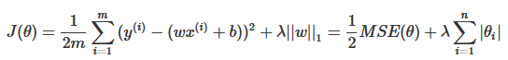
Lasso regression
Lasso regression is very similar to ridge regression, the difference is that they use different regularization terms
It prevents the effect of overfitting by constraining parameters. Lasso can shrink the parameters of some features with relatively small effects to 0 to obtain sparse solutions
That is to say, with this method, the purpose of dimensionality reduction (feature screening) is achieved in the process of training the model
Cost function:

Slide 13
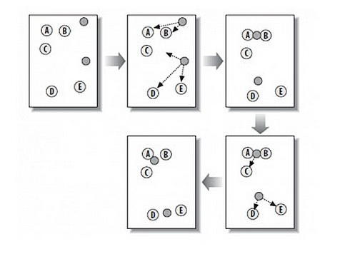
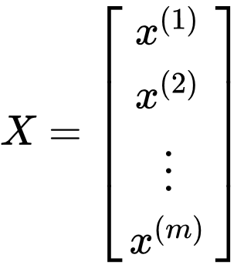
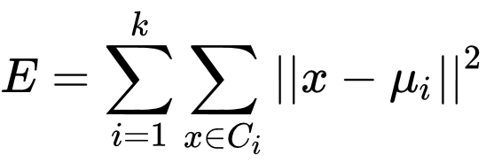
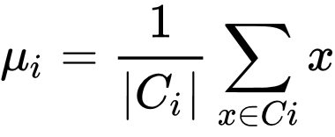
K-Means
The K-Means algorithm is an unsupervised classification algorithm, assuming unlabeled data sets:
The task of this algorithm is to cluster the data set into C = {C1, C2, ..., Ck}. The minimization loss function is:
To find the optimal solution to the above problem, it is necessary to traverse all possible cluster divisions
The K-means algorithm uses an specific strategy to find an approximate solution
µ is the central point of Ci:

Slide 14
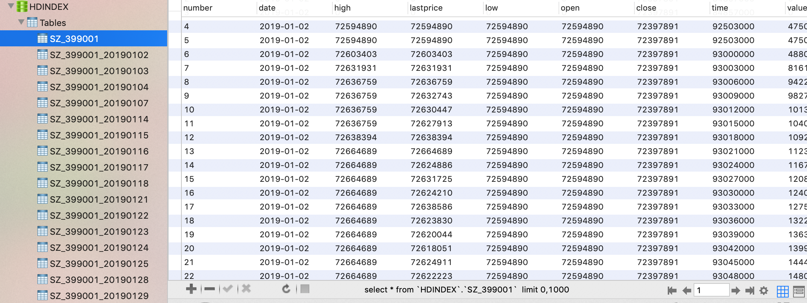
Database – MySQL. Advantages:
Our data is structured so we can use a relational database
The database is mainly used for storage, and the amount of data calculation is not large, so there is no need to choose a specific time series database
Simple operation and convenient query
Faster than excel

Slide 15
Data processing:
1. Connect data from different dates
2. Remove data outside transaction time and deduplicate
3. To ensure the consistency of different index data, we take the intersection of trading dates and times between different indices

Slide 16
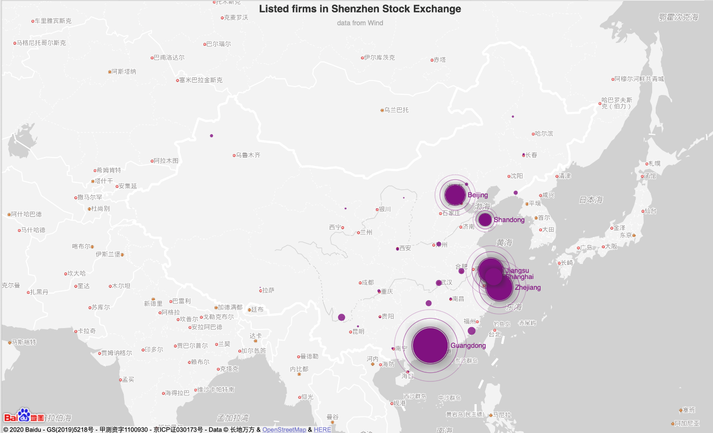
用户可以在投影仪或者计算机上进行演示也可以将演示文稿打印出来
5

Slide 17
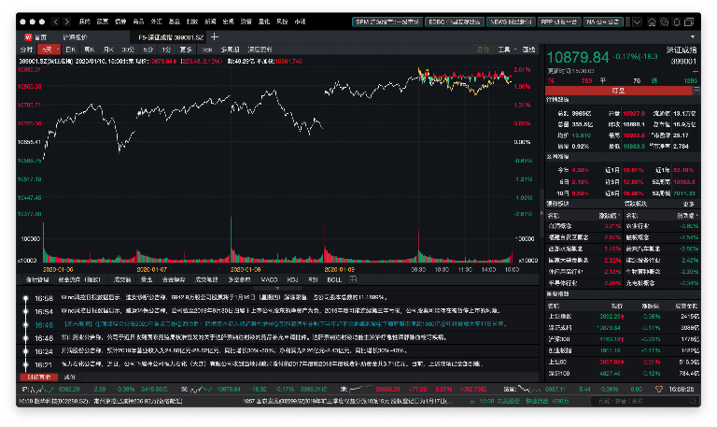
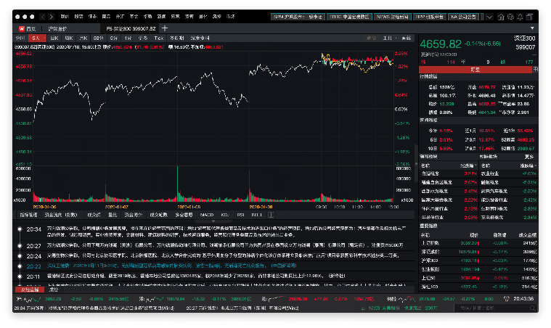
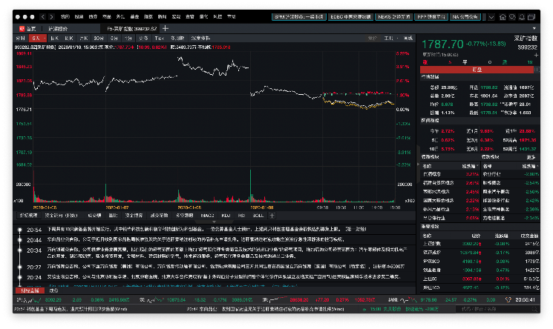
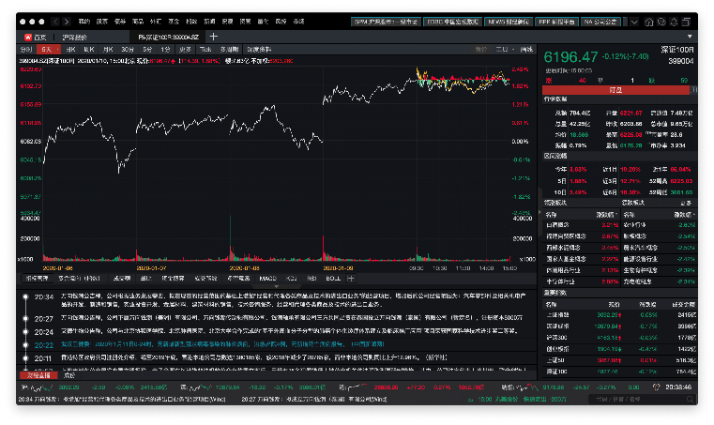
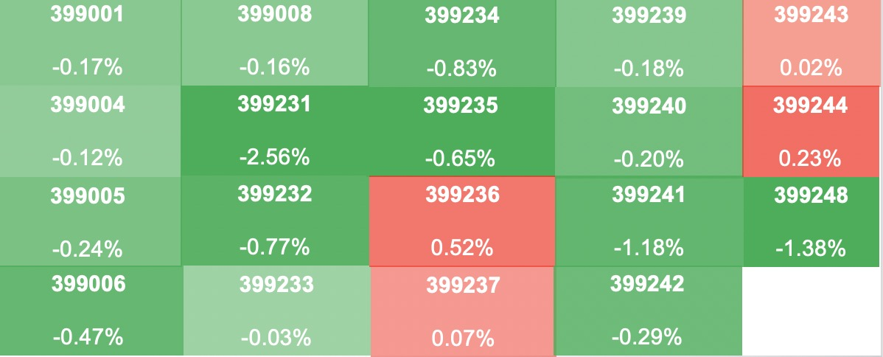
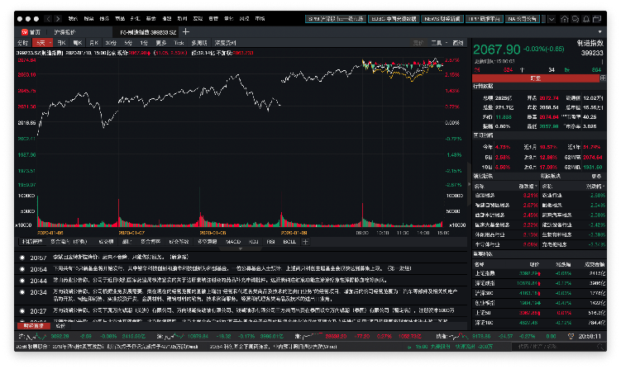
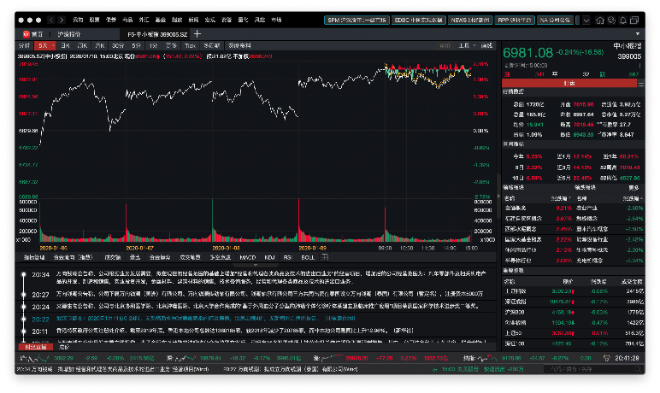
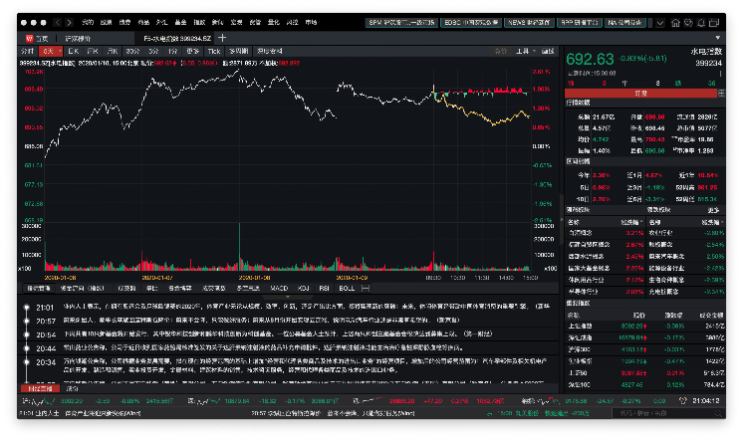
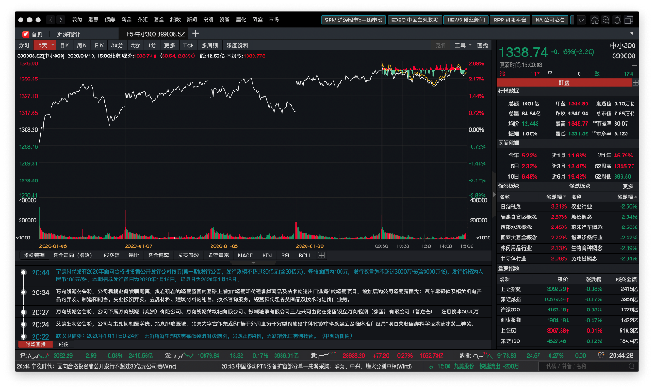
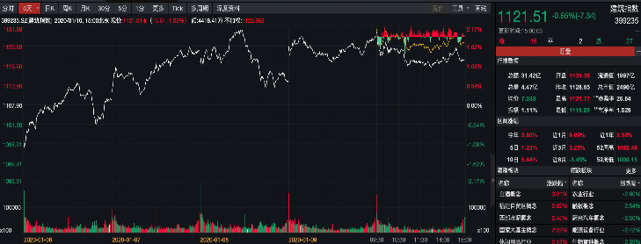
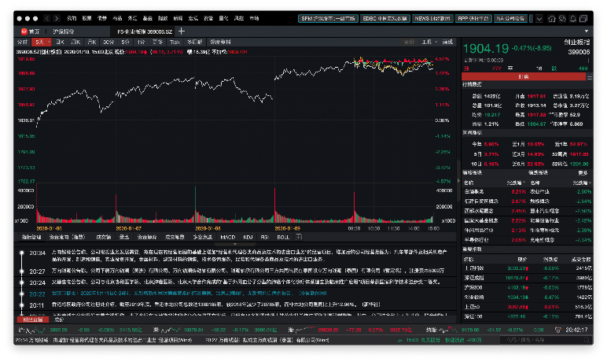
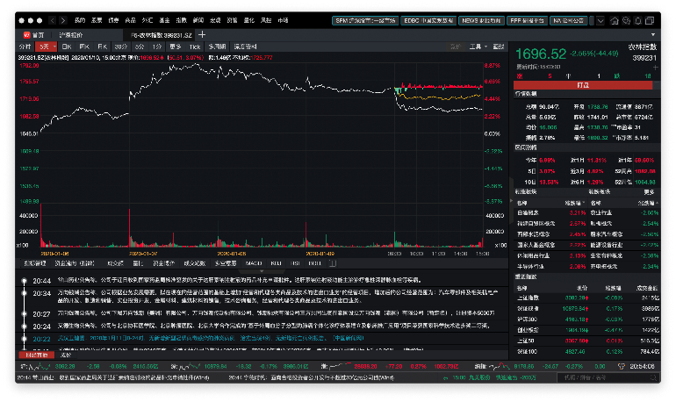
Make money with these GREEN
用户可以在投影仪或者计算机上进行演示也可以将演示文稿打印出来
5

Slide 18
Assumptions
Indexes can be traded
Trading can be executed immediately
Traders can make decision every three seconds
There is enough principal to start the transaction
If we consider cost, the cost is 1bp of trading value and no other cost
Whether indexes can be short or not can be determined by us

Slide 19
LSTM introduces the memory cell - unit of computation that replaces traditional artificial neurons in the hidden layer of the network
With these memory cells, networks are able to effectively associate memories and input remote in time
Hence, LSTM suits to grasp the structure of data dynamically over time and gives high prediction capacity
Motivation behind LSTM for time series data

Slide 20


LSTM structure
The key to LSTMs is the cell state
The LSTM does have the ability to remove or add information to the cell state, carefully regulated by structures – gates
An LSTM has three of these gates, to protect and control the cell state
Regular RNN structure
The sigmoid layer outputs numbers between 0 and 1, describing how much of each component should be let through
A value of zero means “let nothing through,” while a value of one means “let everything through!”
LSTM structure

Slide 21

1
2
STAGE 1
Raw Data
Shenzhen and Shanghai indexes over 3 month
Around 250 000 observations of 10 variables
STAGE 2
Feature Creation
Log of price ratio with the time difference 3, 6, 9, 15, 30, 60, 90, 120 seconds
Change in the volume/value

Slide 22
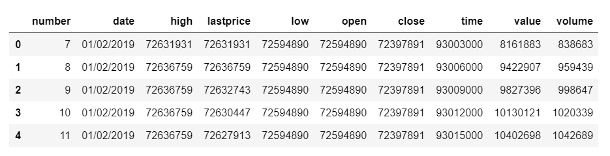
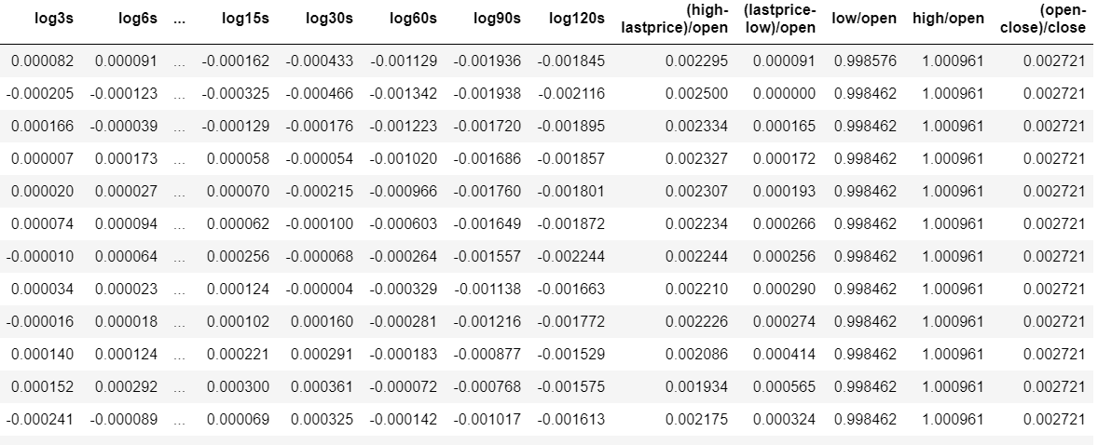
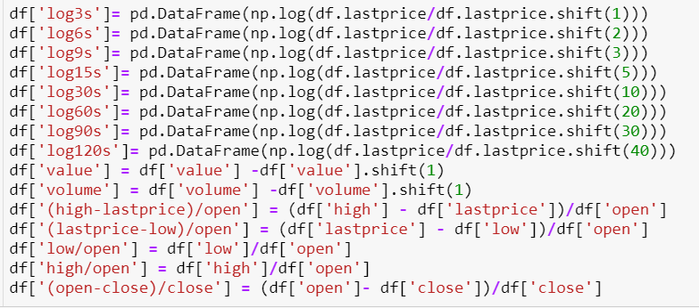
Feature creation
Log of price change ratio with the time difference 3, 6, 9, 15, 30, 60, 90, 120 seconds
Change in the volume/value

Slide 23
1
2
3
STAGE 1
Raw Data
Shenzhen and Shanghai indexes over 3 month
Around 250 000 observations of 10 variables
STAGE 2
Feature Creation
Log of price ratio with the time difference 3, 6, 9, 15, 30, 60, 90, 120 seconds
Change in the volume/value
STAGE 3
Training LSTM
Sequential input layer
One LSTM layer and 3 Dense layers with the custom activation function atan
Output layer with the softmax activation function

Slide 24
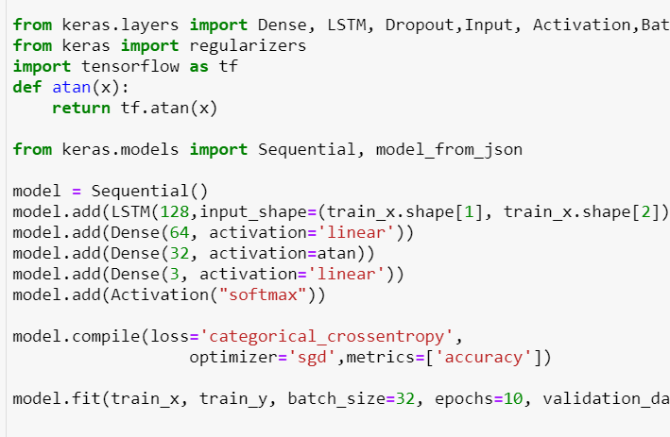
Training LSTM
Sequential input layer
One LSTM layer and 3 Dense layers with the custom activation function atan and the linear activation function
Dropout 0.1 to reduce overfitting:
Regularization method where input and recurrent connections to LSTM units are probabilistically excluded from activation and weight updates while training a network

Slide 25
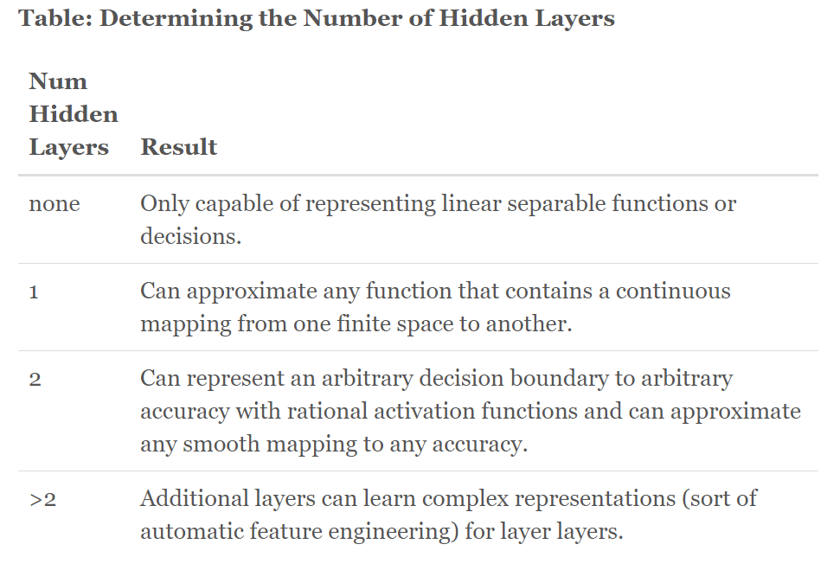
Defining the number of layers & neurons
Most commonly used rules based on the research:
The number of hidden neurons should be between the size of the input layer and the size of the output layer.
The number of hidden neurons should be 2/3 the size of the input layer, plus the size of the output layer.
The number of hidden neurons should be less than twice the size of the input layer.
Source: Jeff Heaton, Ph.D Data Science

Slide 26

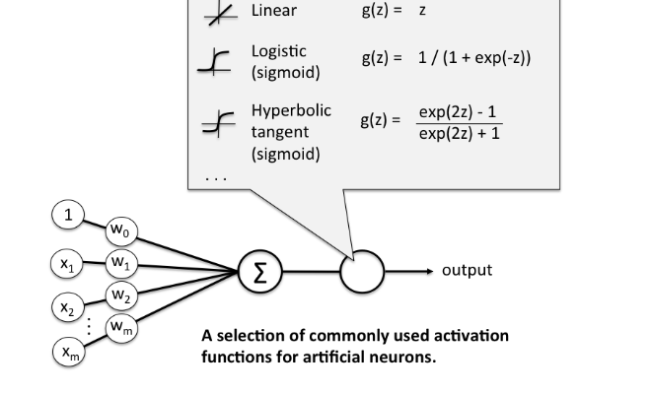
LSTM - activation functions

Slide 27
1
2
3
4
STAGE 1
Raw Data
Shenzhen and Shanghai indexes over 3 month
Around 250 000 observations of 10 variables
STAGE 2
Feature Creation
Log of price ratio with the time difference 3, 6, 9, 15, 30, 60, 90, 120 seconds
Change in the volume/value
STAGE 3
Training LSTM
Sequential input layer
One LSTM layer and 3 Dense layers with the custom activation function atan
Output layer with the softmax activation function
STAGE 4
Parameter tuning
Trying using continuous and categorical data for the change in price
Trying different number of the timesteps

Slide 28
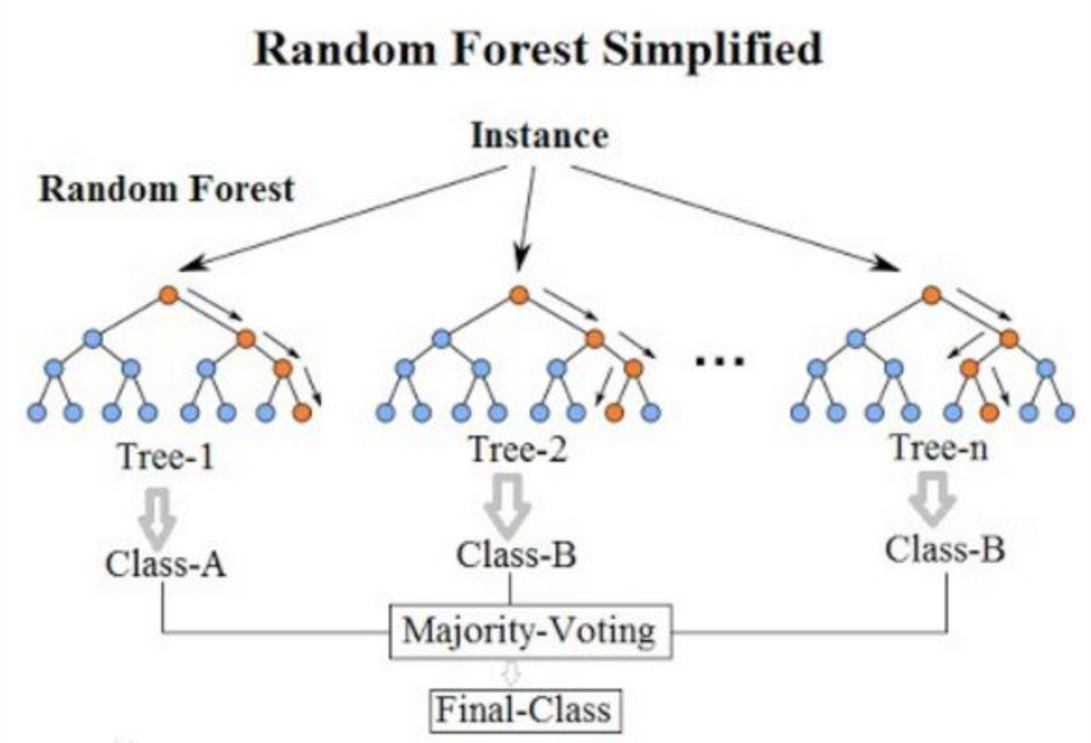
Random Forest
What is Random Forest？
What is Random?
Random forest uses bootstrap resampling technology to generate a new training sample set, and generate classification trees to form a random forest.
A. Sample choosing
B. Feature choosing
What is Forest?
An improvement of decision tree algorithm. There are many decision trees in the forest, and each decision tree select samples independently

Slide 29
Random forest is mainly used in regression and classification. Random forest is very suitable for stock or stock timing as a classifier
Random forest is an integrated learning. Decision trees are independent of each other and make the final classification decision by voting and the accuracy is improved
The noise of financial data is large, and the randomness of random forest can reduce over fitting and the impact of noise
Motivation behind Random Forest for Index Timing

Slide 30
Random Forest
Advantages
Disadvantages
Bootstrap and feature selection reduce the overfitting problem
Good anti noise ability
High accuracy
Can deal with both discrete data and continuous data without normalization
Easy to implement and fast to train
Not sensitive to parameters
Random forest likes a black box, and it is hard to control the internal operation of the model.
Imprecise when dealing with features with multiple value divisions

Slide 31
1
2
Lasso Feature Choosing
Delete features: low, open, close, low/open, high/open
Leave features: high, lastprice, volume, log3s, log6s, log9s, log15s, log30s, log60s, log90s, log120s, (high-lastprice)/open, (lastprice-low)/open, (open-close)/close
STAGE 1
The STAGE 1 & 2 in LSTM
Raw Data
Feature Creation
STAGE 2
Feature Choosing
Use Lasso regression
Delete 5 features and leave 14 features
Train set: before 26/03/2019, 55 days
Test set: 27,28,29/03/2019, 3 days
Index Choosing
Twenty indexes
Feature Choosing

Slide 32
Choosing indexes
Number | Name
399001 | 深证成份指数
399004 | 深证 100指数
399005 | 中小板指数P
399006 | 创业板指数P
399007 | 深证300价格
399008 | 中小板300P
399231 | 农林牧渔指数
399232 | 采矿业指数
399233 | 制造业指数
399234 | 水电煤气指数
Number | Name
399235 | 建筑业指数
399236 | 批发零售指数
399237 | 运输仓储指数
399239 | 信息技术指数
399240 | 金融业指数
399241 | 房地产业指数
399242 | 商务服务指数
399243 | 科研服务指数
399244 | 公共环保指数
399248 | 文化传播指数

Slide 33
1
2
3
STAGE 1
The STAGE 1 & 2 in LSTM
Raw Data
Feature Creation
STAGE 2
Feature Choosing
Use Lasso regression
Delete 5 features and leave 14 features
Index Choosing
Twenty indexes
Train set: before 26/03/2019, 55 days
Test set: 27,28,29/03/2019, 3 days
Feature Choosing
STAGE 3
Training Random Forest
Changing parameters and data frequency
Making Strategy
Parameters in RF:
Trees number = 5
Input features: after Lasso selection

Slide 34
Trading Strategy
Input frequency: 3s or 1min?
Output frequency: predication for 3s or 1min?
How to define price up or down or stable?
How to show investor risk preference on trading strategy?
Other detail:
Allow short or not
How to calculate cost

Slide 35
Our Answer
Choosing 3s as the interval of input features
Predicting 1min trend(price up or down or stable) of price every 3s
Price Up(1): $\frac{Return}{max_return in train or test set}>$ 0.005
Price Stable(0): -0.005 < $\frac{Return}{max_return in train or test set}$ < 0.005
Price Down(-1): $\frac{Return}{max_return in train or test set}<$ -0.005
Price Up(1): Return/(max_return in train or test set)> 0.005
Price Stable(0): -0.005 < Return/(max_return in train or test set) < 0.005
Price Down(-1): Return/(max_return in train or test set)< -0.005
Investor risk preference [a, b] and max long c: When prediction is stable(0), we generate a random number between 0 and 1. If the random number is less than a, long the index. If the random number is larger than b, short the index. [a, b] is given by investors. The total long size should be less than c.

Slide 36
Trading Strategy
One Strategy: make decision every 60s
Make decision i.e. prediction is 1, long index
Close the position 1min ago and make decision i.e. short index(if 0s is long) and if 60s prediction is 1, long index
Do the same as 60s ago
0s
60s
120s
Multiple Strategy: make decision every 3s
Make decision
Close the position 1min ago and make decision
Do the same as 60s ago
0s
60s
120s
Close the position 1min ago and make decision
Make decision
Do the same as 60s ago
3s
63s
123s
………
Strategies are combined together only by having one total long size limit

Slide 37
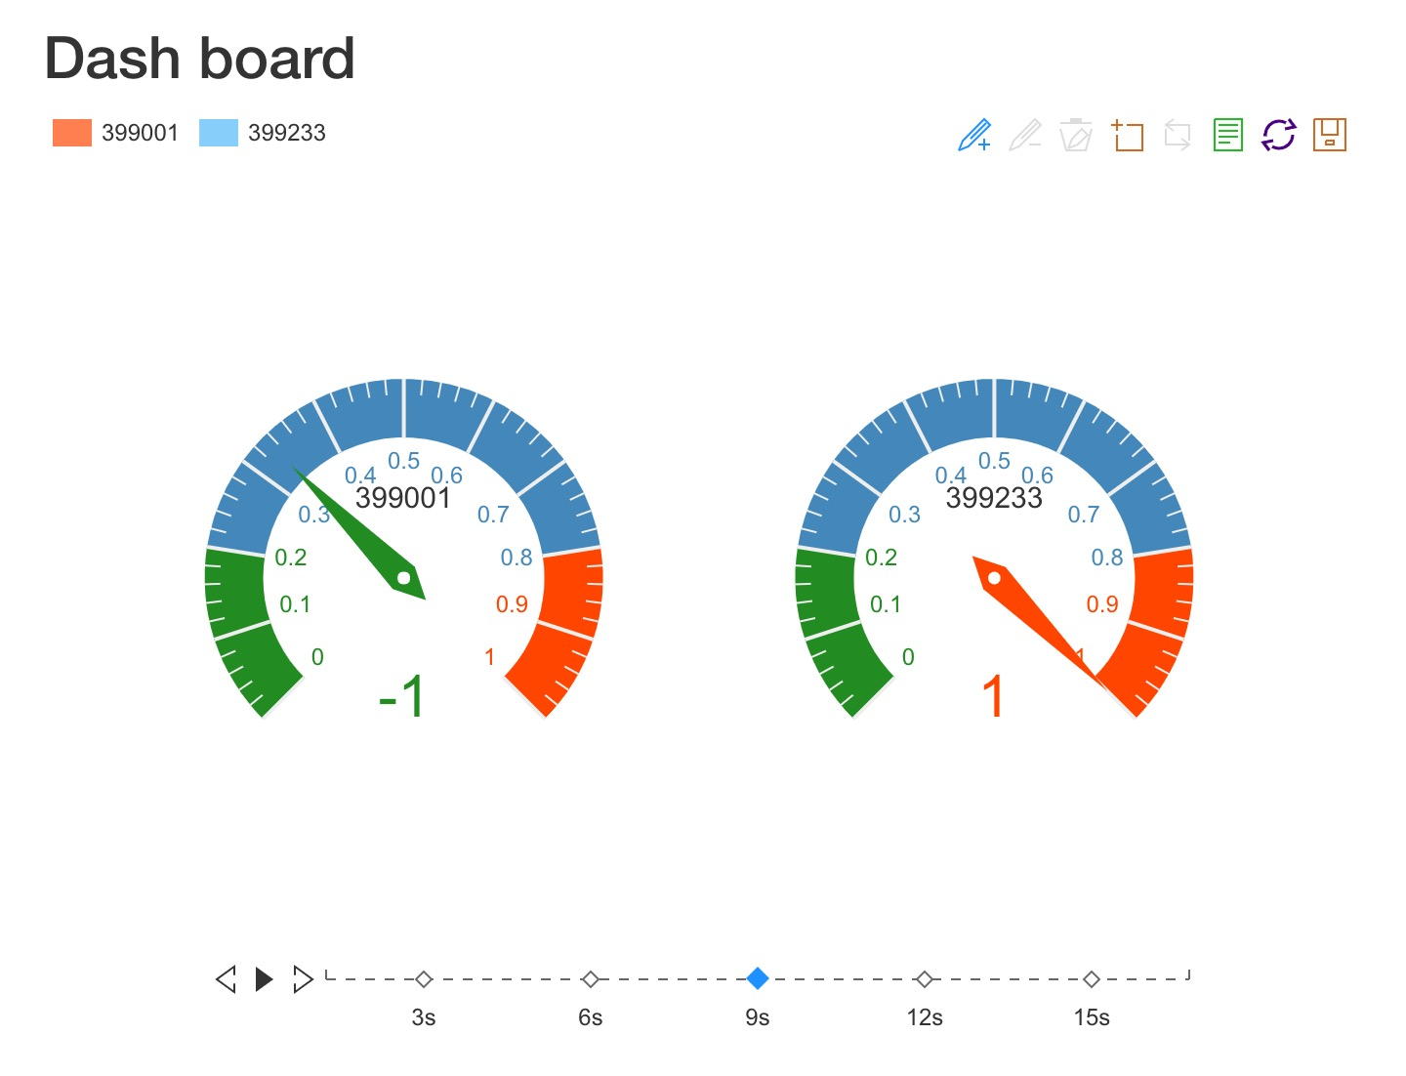
Results : prediction accuracy
 | SZ_399001 | SZ_399004 | SZ_399005 | SZ_399006 | SZ_399007 | SZ_399008 | SZ_399231 | SZ_399232 | SZ_399233 | SZ_399234 | SZ_399235 | SZ_399236 | SZ_399237 | SZ_399239 | SZ_399240 | SZ_399241 | SZ_399242 | SZ_399243 | SZ_399244 | SZ_399248
training accuracy | 0.989565 | 0.988646 | 0.988919 | 0.989259 | 0.989056 | 0.989557 | 0.988286 | 0.986224 | 0.990158 | 0.986866 | 0.987031 | 0.986505 | 0.988377 | 0.989044 | 0.9873 | 0.986853 | 0.98516 | 0.987603 | 0.98711 | 0.988207
testing accuracy | 0.651032 | 0.615255 | 0.616381 | 0.546729 | 0.633707 | 0.652018 | 0.466371 | 0.501725 | 0.685541 | 0.554053 | 0.539122 | 0.590746 | 0.496866 | 0.631242 | 0.552363 | 0.541024 | 0.505036 | 0.539263 | 0.535601 | 0.531798
CV accuracy | 0.262263 | 0.224961 | 0.229627 | 0.1845 | 0.248382 | 0.254056 | 0.146989 | 0.326825 | 0.323289 | 0.238865 | 0.211895 | 0.27419 | 0.216438 | 0.213734 | 0.247036 | 0.314123 | 0.392847 | 0.246047 | 0.288866 | 0.227202
3

Slide 38
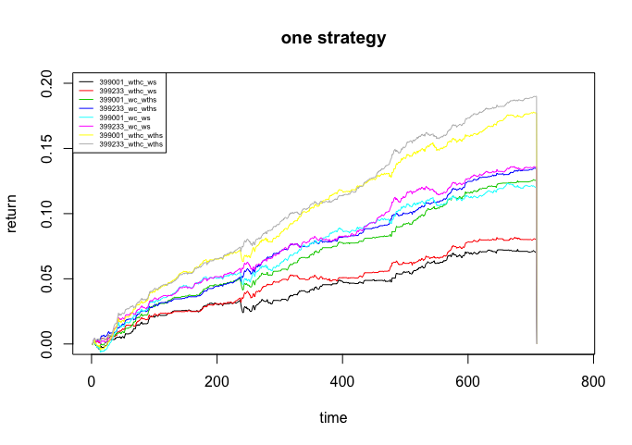
Results： one strategy
 | SZ_399001 | SZ_399004 | SZ_399005 | SZ_399006 | SZ_399007 | SZ_399008 | SZ_399231 | SZ_399232 | SZ_399233 | SZ_399234 | SZ_399235 | SZ_399236 | SZ_399237 | SZ_399239 | SZ_399240 | SZ_399241 | SZ_399242 | SZ_399243 | SZ_399244 | SZ_399248
Buy | 227 | 335 | 263 | 228 | 243 | 275 | 263 | 217 | 246 | 255 | 281 | 252 | 260 | 264 | 267 | 272 | 259 | 243 | 262 | 253
Sale | 143 | 157 | 172 | 152 | 155 | 180 | 163 | 139 | 164 | 162 | 155 | 169 | 161 | 170 | 174 | 173 | 171 | 177 | 170 | 169
No action | 340 | 318 | 272 | 330 | 312 | 253 | 281 | 354 | 300 | 293 | 313 | 289 | 289 | 276 | 269 | 265 | 280 | 290 | 278 | 288
3

Slide 39
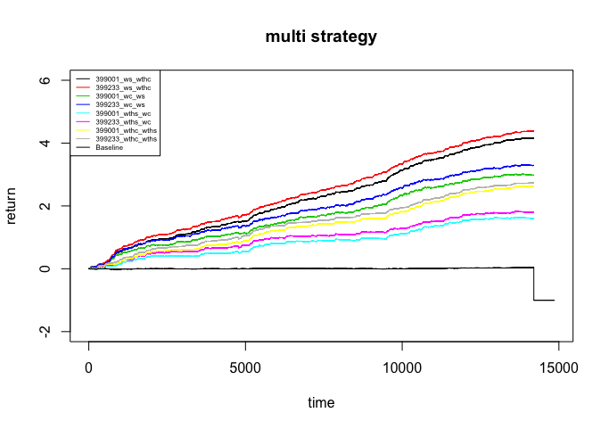
Results： Multi strategy
 | SZ_399001 | SZ_399233
Buy with short | 3083 | 2918
Sale with short | 3094 | 2910
No action with short | 8022 | 8371
Buy without short | 4033 | 3760
Sale without short | 3584 | 7181
No action without short | 6582 | 3258
3

Slide 40
Results 1
 | SZ_399001 | SZ_399004 | SZ_399005 | SZ_399006 | SZ_399007 | SZ_399008 | SZ_399231 | SZ_399232 | SZ_399233 | SZ_399234 | SZ_399235 | SZ_399236 | SZ_399237 | SZ_399239 | SZ_399240 | SZ_399241 | SZ_399242 | SZ_399243 | SZ_399244 | SZ_399248
one strategy
max_drawback(without cost) | -0.003436 | -0.005523 | -0.004658 | -0.00611 | -0.005625 | -0.004185 | -0.011902 | -0.00878 | -0.003689 | -0.005284 | -0.005049 | -0.004434 | -0.004842 | -0.007019 | -0.017433 | -0.008442 | -0.011331 | -0.008862 | -0.006863 | -0.012102
cannot short one strategy
trade amount | 370 | 393 | 395 | 440 | 378 | 402 | 452 | 426 | 357 | 409 | 412 | 400 | 416 | 423 | 433 | 441 | 444 | 431 | 432 | 421
return_withoutc | 0.125609 | 0.087675 | 0.149955 | 0.053257 | 0.135963 | 0.149941 | 0.020534 | 0.021078 | 0.134748 | 0.033311 | 0.049033 | 0.086772 | 0.058192 | 0.127435 | 0.102076 | 0.047683 | 0.05583 | 0.066977 | 0.025055 | 0.044627
return withc | 0.070258 | 0.026297 | 0.090479 | -0.011836 | 0.075908 | 0.089072 | -0.049599 | -0.042524 | 0.080394 | -0.031357 | -0.011262 | 0.025162 | -0.006049 | 0.065517 | 0.036181 | -0.022072 | -0.012053 | 0.000678 | -0.042323 | -0.019072
can short one strategy
trade amount | 370 | 393 | 395 | 440 | 378 | 402 | 452 | 426 | 357 | 409 | 412 | 400 | 416 | 423 | 433 | 441 | 444 | 431 | 432 | 421
return_withoutc | 0.125609 | 0.087675 | 0.149955 | 0.053257 | 0.135963 | 0.149941 | 0.020534 | 0.021078 | 0.134748 | 0.033311 | 0.049033 | 0.086772 | 0.058192 | 0.127435 | 0.102076 | 0.047683 | 0.05583 | 0.066977 | 0.025055 | 0.044627
return withc | 0.070258 | 0.026297 | 0.090479 | -0.011836 | 0.075908 | 0.089072 | -0.049599 | -0.042524 | 0.080394 | -0.031357 | -0.011262 | 0.025162 | -0.006049 | 0.065517 | 0.036181 | -0.022072 | -0.012053 | 0.000678 | -0.042323 | -0.019072
Multi-strategy
max_drawback(without cost) | -0.011786 | -0.011204 | -0.015953 | -0.015172 | -0.010943 | -0.01611 | -0.020262 | -0.016028 | -0.012343 | -0.012371 | -0.019908 | -0.009316 | -0.017192 | -0.019581 | -0.020336 | -0.012147 | -0.036177 | -0.018223 | -0.016334 | -0.016284
cannot short one strategy
trade amount | 7617 | 8064 | 7971 | 8852 | 7993 | 7590 | 9361 | 9223 | 7018 | 8369 | 8572 | 8211 | 8933 | 8088 | 8648 | 8717 | 9124 | 8690 | 8820 | 8692
return_withoutc | 1.588357 | 1.196376 | 3.512374 | 0.265724 | 1.543475 | 2.74368 | 1.373875 | 0.14477 | 1.708647 | 0.850711 | 2.07111 | 1.550624 | -0.597341 | 1.525142 | 0.469731 | 2.438844 | 1.50776 | 0.913166 | 1.124002 | 2.008798
return withc | 0.568705 | 0.083898 | 2.463888 | -0.930972 | 0.461969 | 1.748487 | 0.015708 | -1.095948 | 0.772382 | -0.321249 | 0.918336 | 0.397336 | -1.847263 | 0.475629 | -0.69277 | 1.24285 | 0.233465 | -0.289381 | -0.052509 | 0.811558
can short one strategy
trade amount | 6177 | 6607 | 6412 | 6908 | 6516 | 6114 | 7528 | 6773 | 5828 | 6608 | 6735 | 6478 | 7062 | 6492 | 6768 | 6540 | 6948 | 6798 | 6738 | 6809
return_withoutc | 3.119321 | 2.218156 | 4.860389 | 1.094691 | 2.861398 | 5.452144 | 1.072397 | 1.612259 | 3.363321 | 2.60835 | 3.124537 | 3.73599 | -0.305414 | 3.670658 | 1.626234 | 2.869467 | 2.136861 | 2.813991 | 2.785446 | 1.804636
return withc | 1.9464 | 0.946925 | 3.641556 | -0.23155 | 1.616355 | 4.290793 | -0.350759 | 0.305065 | 2.26711 | 1.332725 | 1.865487 | 2.468887 | -1.642177 | 2.448217 | 0.334005 | 1.56782 | 0.801472 | 1.501944 | 1.463622
3

Slide 41
1
2
3
4
STAGE 1
Raw Data
Shenzhen and Shanghai indexes over 3 month
Around 250 000 observations of 10 variables
STAGE 2
Feature Choosing
Use Lasso regression
Delete 5 features and leave 14 features
Index Choosing
Twenty indexes
Train set: before 26/03/2019, 55 days
Test set: 27,28,29/03/2019, 3 days
Feature Choosing
STAGE 3
Training Random Forest
Changing parameters
Making Strategy
Results analysis
STAGE 4
K-means for indexes
Pair trading strategy
Results analysis

Slide 42
Pair trading strategy
Clustering based on the last price
Number of clusters are 2
The first three indexes are the same clusters
K-means
Select one index from each clusters based on the prediction accuracy. (399001, 399233)
Index selection
Find the time when the price changes of the two indices are inconsistent, and make corresponding transactions.
Pair trading strategy
Make money only assuming that there is no cost
Results
11

Slide 43
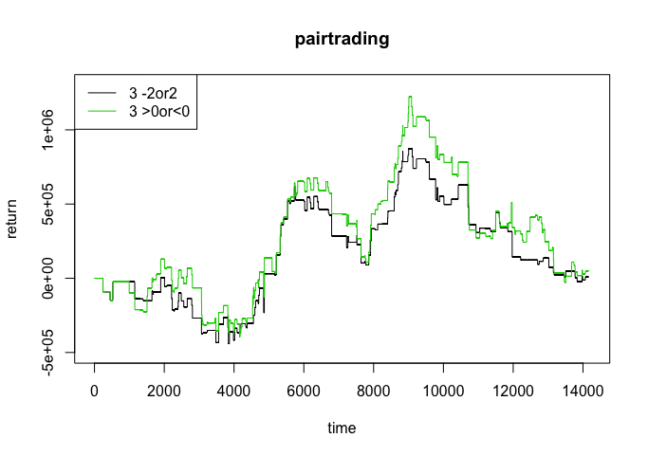
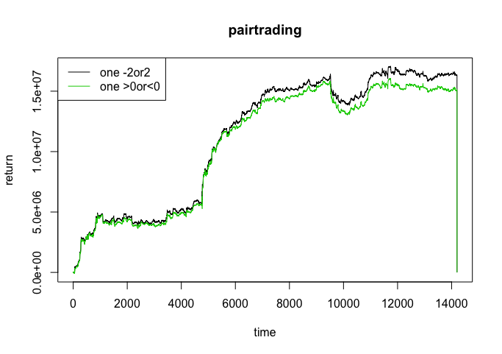
Result
3

Slide 44
非常感谢您的观看
THANK YOU !

